Slide 1

HACKOVER 3.0
JAVA GEEKS
TEAM NO. 130

Slide 2


GAME DEVELOPMENT
PACMAN
GITHUB Repository

Slide 3
TEAM MEMBERS
NAMES | BRANCH
ZANE FALCAO | SE COMPS A
RUDALPH GONSALVES | SE COMPS A
ALROY PEREIRA | SE COMPS A
JOVAN RUMAO | SE COMPS A

Slide 4
FILE STRUCTURE OF GAME PACMAN
PACKAGE
MAIN CLASS
METHODS OF GAMES
GAME PLAY CLASS
DISPLAY ACTOR
OUTPUT
CREATE OBSTACLE

Slide 5
SKELETON OF GAME
MAIN CLASS
1.Public Static Void Main
2.JFrame()
3.Game Play Class() Obj
GAME PLAY CLASS
1.KeyListener()
2.ActionListener()
3.Graphics 2D()
4.JPanel()
5.Timer() Color() Front()
OTHER CLASS
1. Graphics 2D()
2.Color() Front()
3.Enum() For() While()

Slide 6
STRUCTURE OF GAME
START
PLAY
GAME OVER
DESTROYED
START
STOP
SHUTDOWN
RESUME
PAUSE
PAUSE

Slide 7
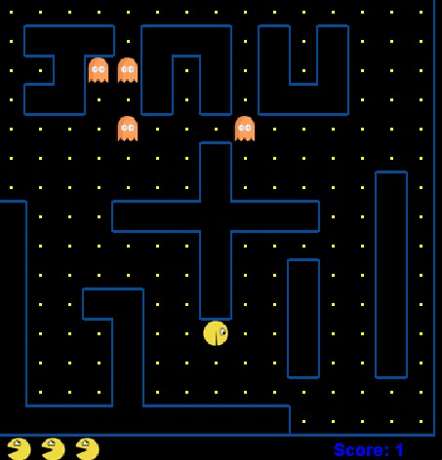
SOURCES
PACMAN GAME
LANG: JAVA
EDITOR: ECLIPSE
FW: AWT
FW: SWING

Slide 8
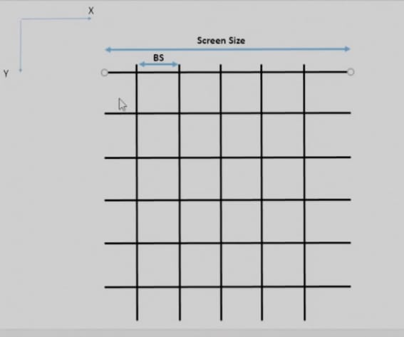
DRAWING THE MAZE ALGORITHM

Slide 9
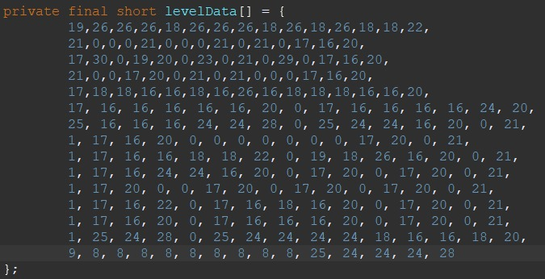
Layout
Array Calculation: 16+8+4 = 28
0 = Empty Space 1 = Left Border 2 = Top Border 4 = Right Border 8 = Bottom Border 16 = Yellow Dot

Slide 10
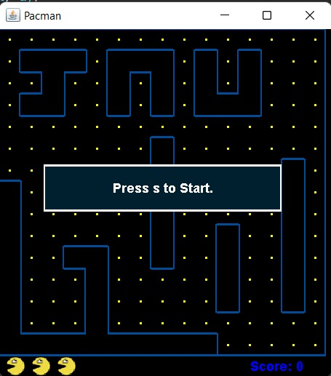
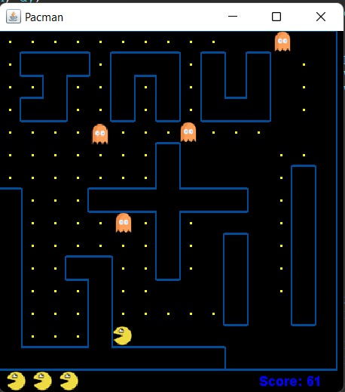
PACMAN…

Slide 11
THANK YOU

